Slide 1

A Study on Improving Profitability and Customer Inflow in a Beauty and Tailoring Business
IITM - BDM PROJECT
Presented by:
Name: EVANGELINE CHRISTINA
Roll Number: 25DS1000087
Mail id: 25ds1000087@ds.study.iitm.ac.in

Slide 2
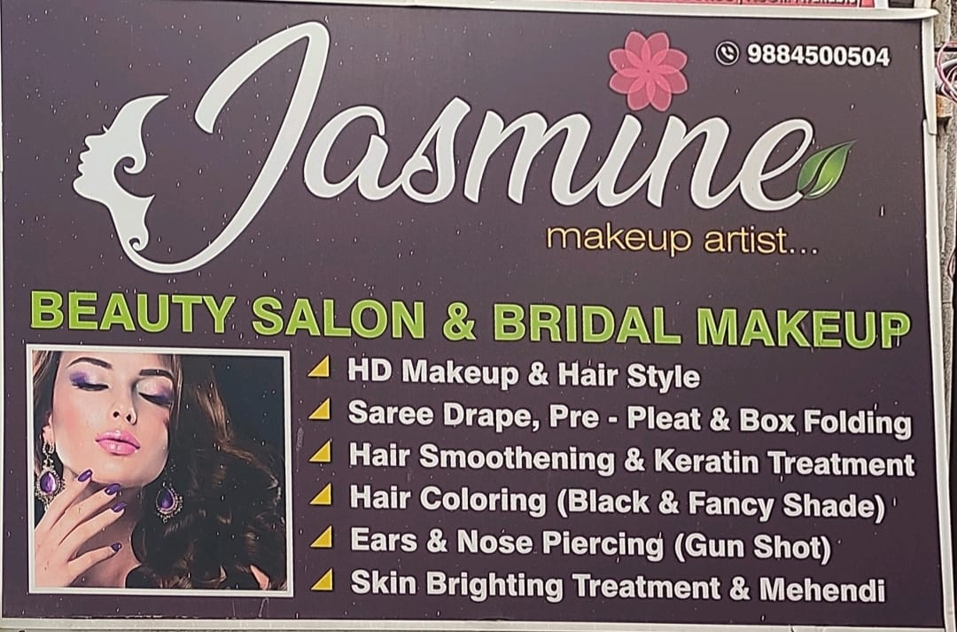
ORGANISATION BACKGROUND
Brief Description of the Organization
Jasmine Beauty Salon, a B2C service business near Ambattur OT, Chennai.
Established in 2017, providing beauty services such as bridal makeup, facials, hair and skin care.
Expanded into tailoring services in May 2024 (blouse stitching, alterations, simple tailoring).
Nature of Its Business
Operates Monday to Saturday, 10:00 AM – 8:30 PM (closed on Sundays).
Business is fully managed by the owner alone, with no additional staff.
Serves local customers through both walk-ins and appointments.

Slide 3
PROBLEM STATEMENT
1
Low Profitability Despite Effort
2
Lack of New Customer Inflow
3
Frequent Customer Bargaining
High number of services delivered, but low average income per service.
Too much effort went into low priced services.
No steady inflow of new customers.
Business depends mainly on repeat customers.
Bargaining common in beauty services.
Leads to inconsistent pricing and revenue loss

Slide 4
DATA COLLECTION AND METHODOLOGY
Pareto Analysis (80/20) → Identified top revenue-driving services (to focus on high-impact areas).
Monthly Trend Analysis → New vs Repeat customer flow (to detect stagnation or growth).
Service Segmentation → Customer type patterns (new vs repeat) (to see loyalty vs acquisition).
Pricing Behaviour Analysis → Highlighted undercharging & bargaining (to measure inconsistency in pricing).
Revenue Loss Estimation → Quantified losses (₹32,000+ in beauty) (to show the financial impact clearly).
Handwritten records from business owner → digitised in Excel.
Period: Beauty (Jul ’24 – Jun ’25), Tailoring (Feb – Jun ’25).
Invalid/missing entries clarified directly with owner.
Cleaned dataset → 611 rows, 5 columns.
Added “Category” column to separate Beauty & Tailoring.
Standardised inconsistent service names & date formats.
Ensured separate analysis for Beauty vs Tailoring to avoid bias.

Slide 5
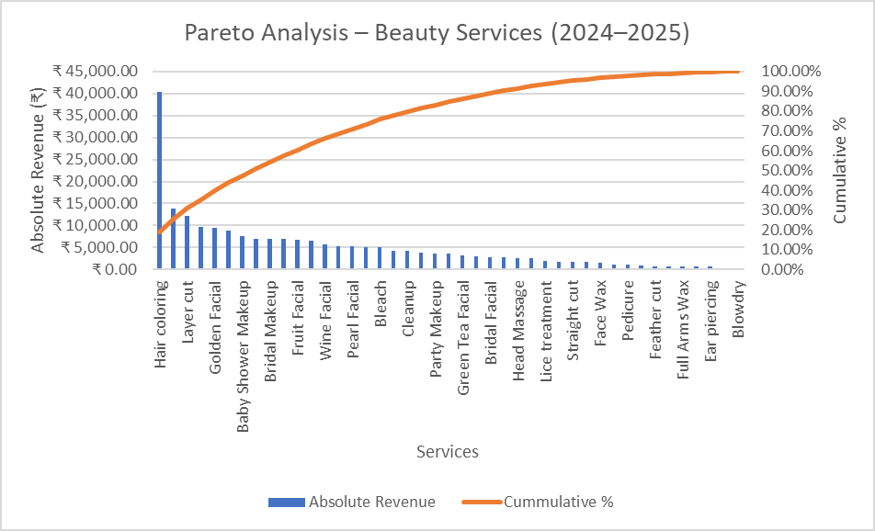
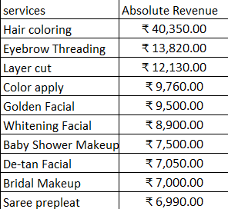
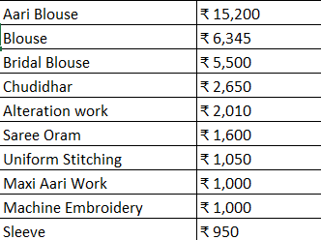
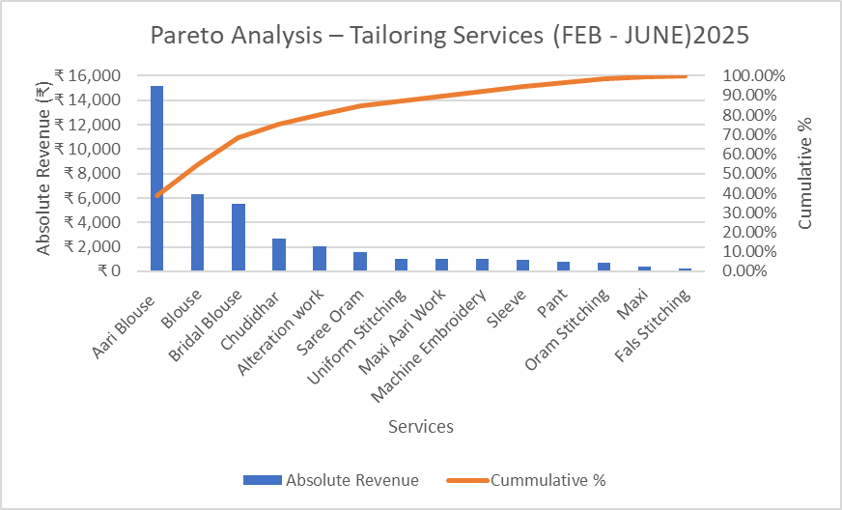
RESULTS AND FINDINGS - Pareto Analysis
A few services (Hair Coloring, Layer Cut, Golden Facial, Baby Shower Makeup, Bridal Makeup) contribute to the majority of revenue (~70–80%).
Long tail of services adds very little revenue.
Clear evidence of 80/20 Rule: ~20% of services are driving ~80% of income.
Aari Blouse alone contributes ~30–35% of total tailoring revenue.
Together with Blouse and Bridal Blouse, top 3 services contribute ~70% revenue.
Other tailoring services are much less significant in revenue share.

Slide 6
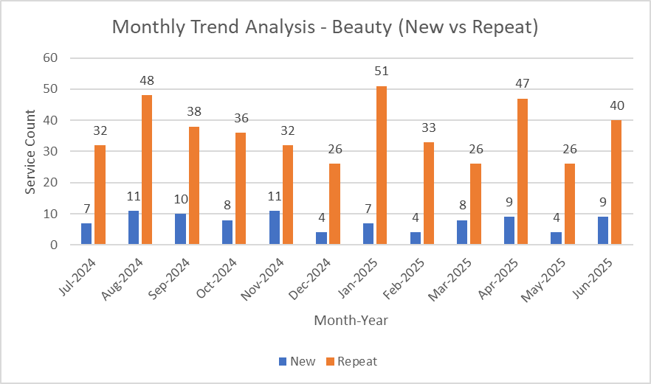
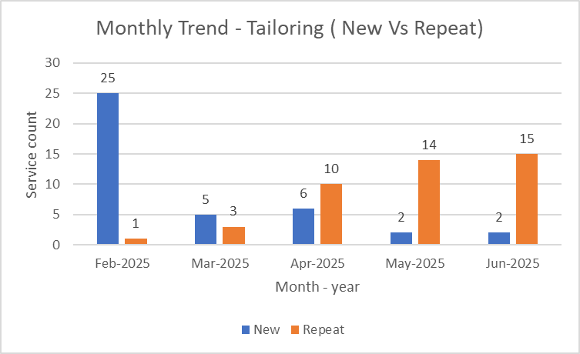
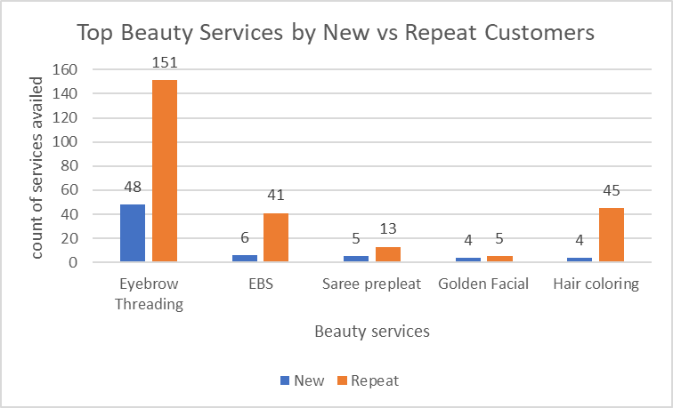
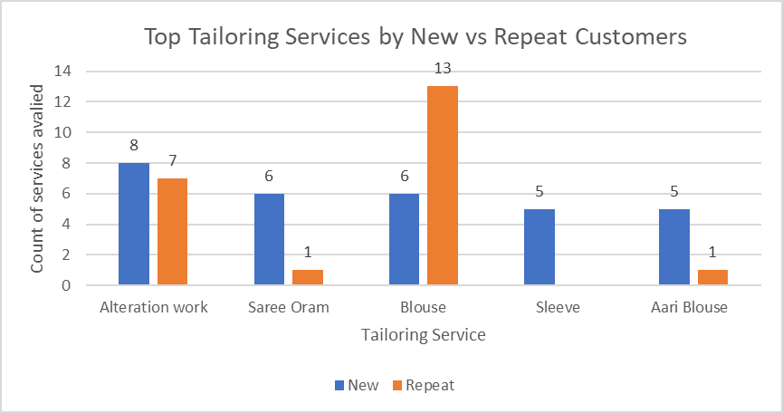
Results and Findings – New Customer Inflow

Slide 7
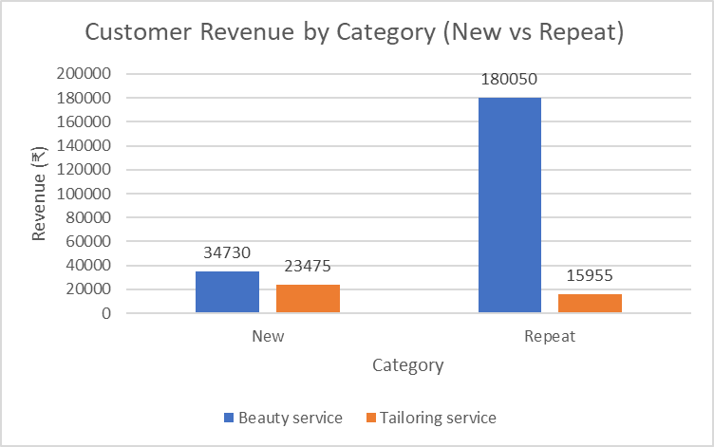
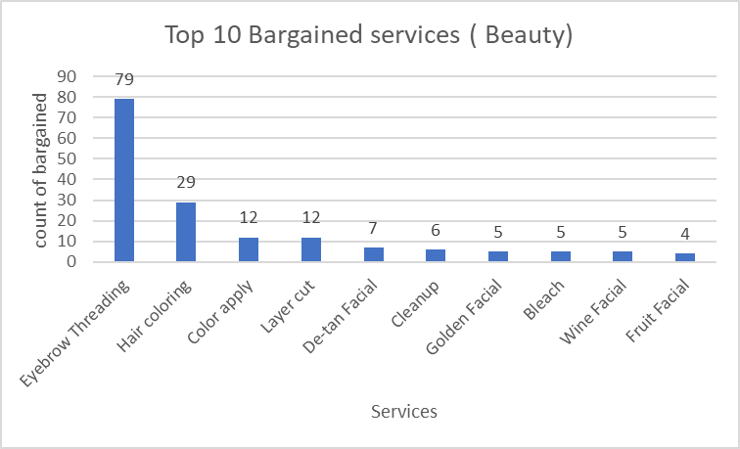
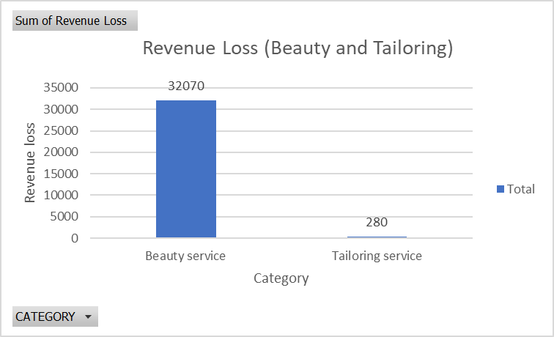
Results – Bargaining & Revenue Loss
Beauty revenue → heavily repeat-driven, very few new customers contribute
Bargaining concentrated in routine beauty services (threading, coloring)
Frequent bargaining in beauty → ₹32,000+ revenue loss.
Tailoring mostly unaffected due to strict pricing.

Slide 8
Interpretation and Recommendations
Set Minimum Prices: Fix a base price for top bargained services like threading and coloring. This will reduce the ₹32K revenue loss and bring consistency in beauty service pricing.
Promote Top Revenue Services: Focus marketing and visibility on services like Hair Coloring, Aari Blouse, and Bridal Blouse. These few services already generate most of the revenue according to Pareto analysis.
Introduce Combo Packages: Bundle low-priced but popular services such as threading + cleanup or facial + waxing. This increases billing value without adding extra workload on the owner.
Attract New Customers: Offer small first-time deals and promote entry services like threading and blouse stitching. This helps convert hesitant new customers and improve inflow.
Highlight High-Margin Services: Place premium services at the top of the rate card or suggest them during consultations. Even a few extra bookings of these high-value services can steadily improve margins.

Slide 9
Conclusion and Next Steps
Conclusion:
Next Steps:
Data-driven analysis revealed key gaps in profitability, customer inflow, and pricing control.
Pareto analysis showed a few top services drive ~70% of revenue, while many low-value services add little.
Revenue loss analysis highlighted ₹32K lost due to bargaining in beauty services.
Recommendations like minimum pricing, combos, and focusing on top services provide clear actions.
The business is now better equipped to improve margins and attract new customers sustainably.
Start using a minimum price for top bargained services to stop revenue loss.
Run a promotional strategy – highlight popular services on WhatsApp, posters, and local groups to attract new customers.
Try combo offers (e.g., threading + cleanup, blouse + alteration) and see how customers respond.
Keep a habit of noting data daily (services, amount, new/repeat) for better monthly tracking.
Slowly move towards digital records to make analysis easier in the future.

Slide 10
THANK YOU

